Slide 1
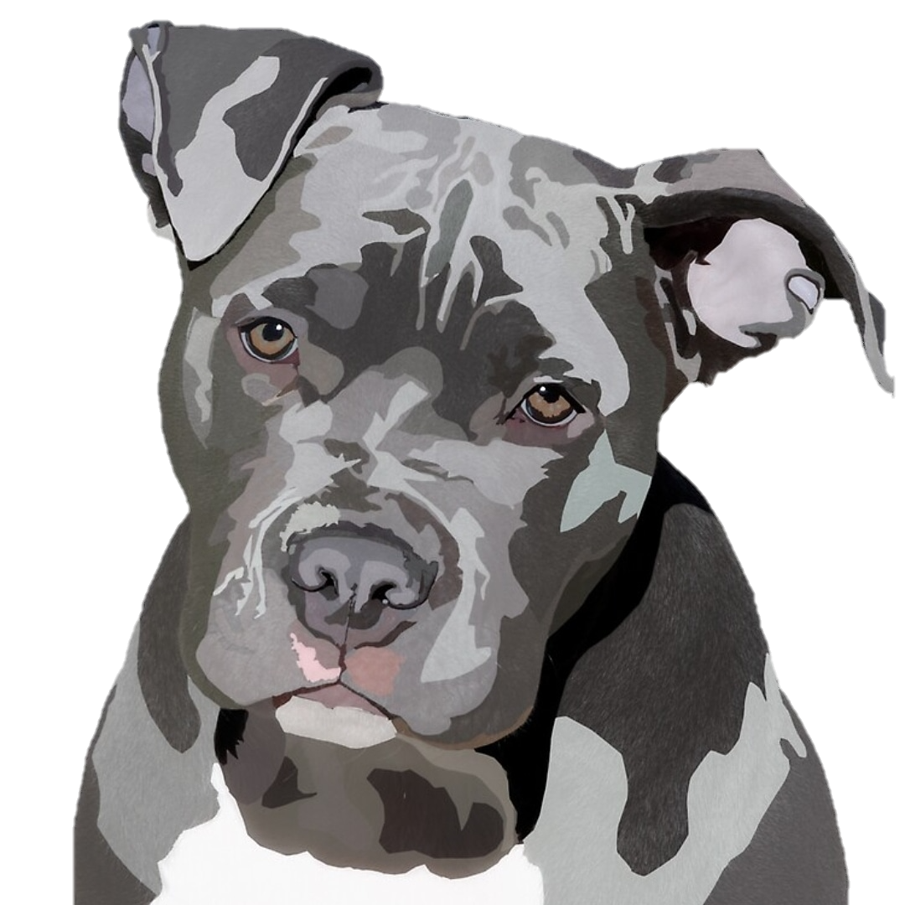
Pitbull Pic
Python Image Classification
Jenny James
Data Scientist
10.12.2020

Slide 2
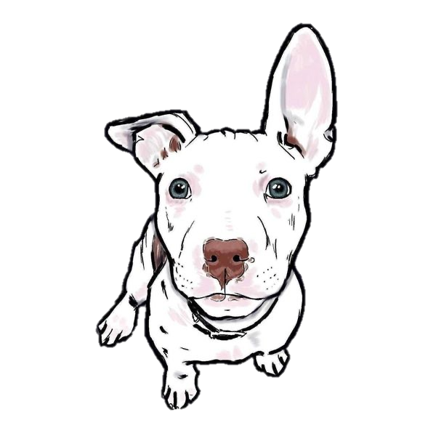
Agenda
Problem Statement
Data Acquisition
EDA
Data Augmentation
Modeling and Results
Conclusions and Future Work

Slide 3

My goal is to use a Convolutional Neural Network (CNN) to create a model that’s able to distinguish between images of pit bulls and images of other breeds of dogs.

Slide 4
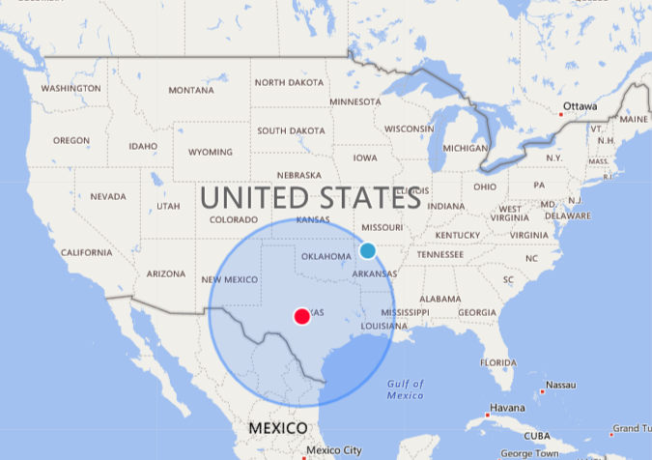
Data Acquisition
Petpy – Petfinder API:
Using the petfinder API I was able to scrape 20,000 images of dogs from the petfinder website.
I did two scrapes: a 500 mile radius around Brady, TX and a 500 mile radius around Nashville, TN
Stanford Dogs Dataset:
A royalty free dataset containing 20,580 images from 120 breeds of dogs from all over the world.
*I used the Staffordshire Bull Terrier and the American Staffordshire Terrier since they are classified as Pit Bulls in the united states.

Slide 5
EDA The Hard Part
For the petfinder images, I cleaned the dataset and kept the largest size image for each dog and downloaded them so that there was a directory for each breed.
I was able to directly download the images from the Stanford dataset.
Before data augmentation or modeling I manually cropped the images so that they were headshots with only slight angles to either side.
Total Images: 1894
Pit Bull Images: 907
Non-Pit Bull Images: 987
Training: 1482
Testing: 412

Slide 6
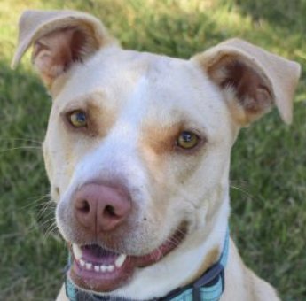
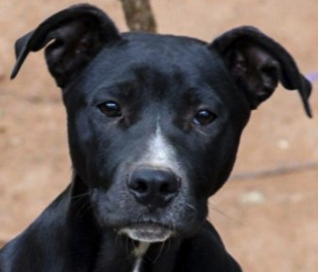
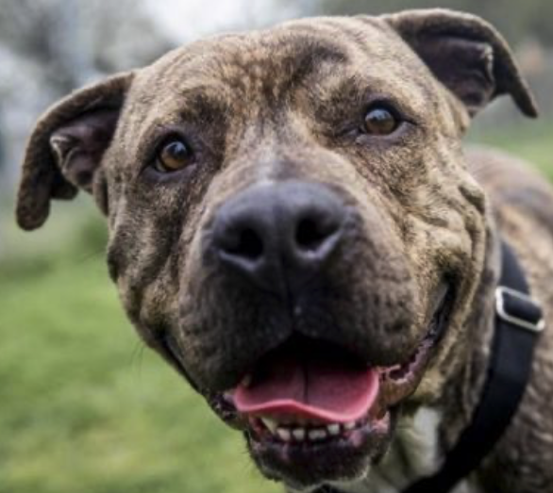
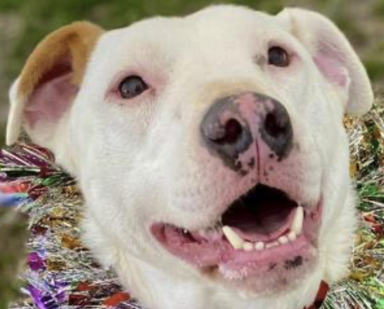
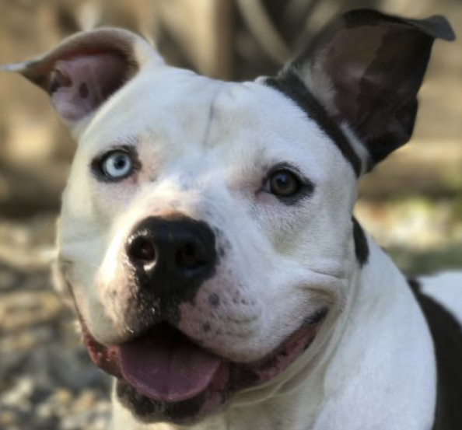
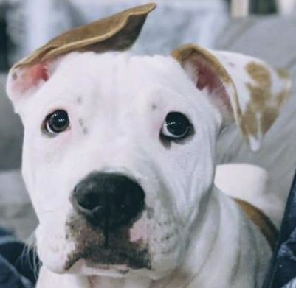
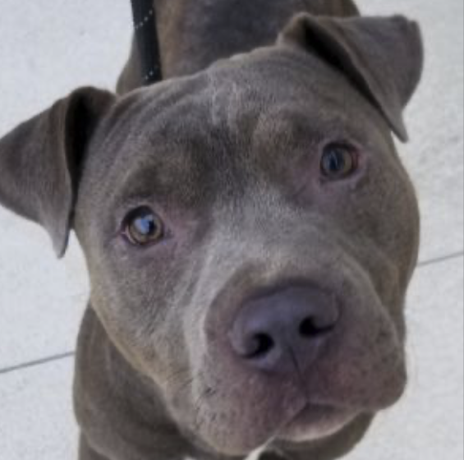
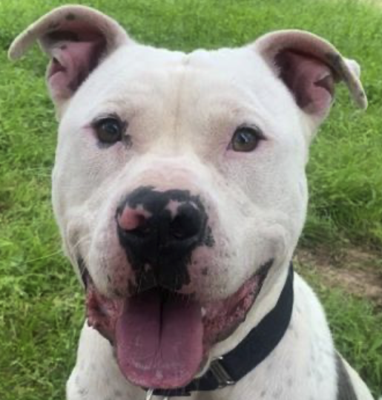
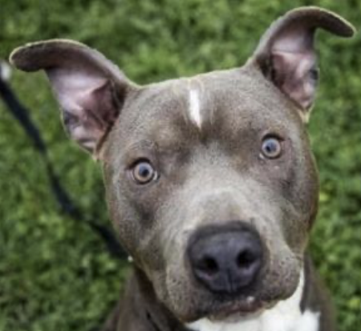
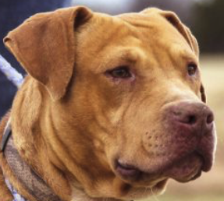
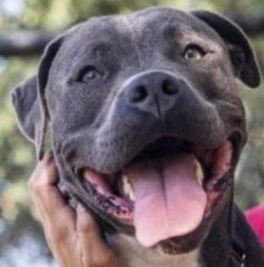
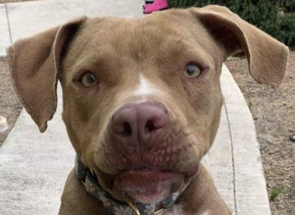
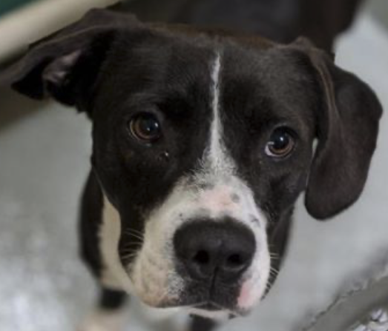
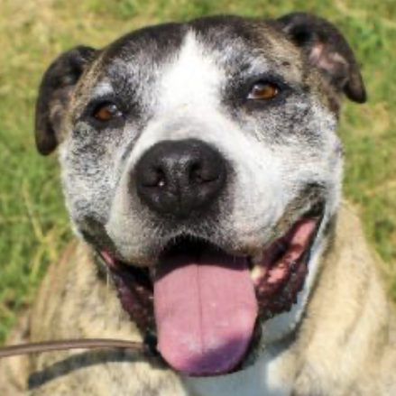
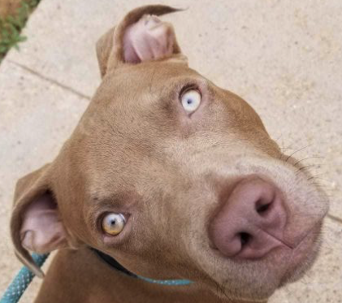
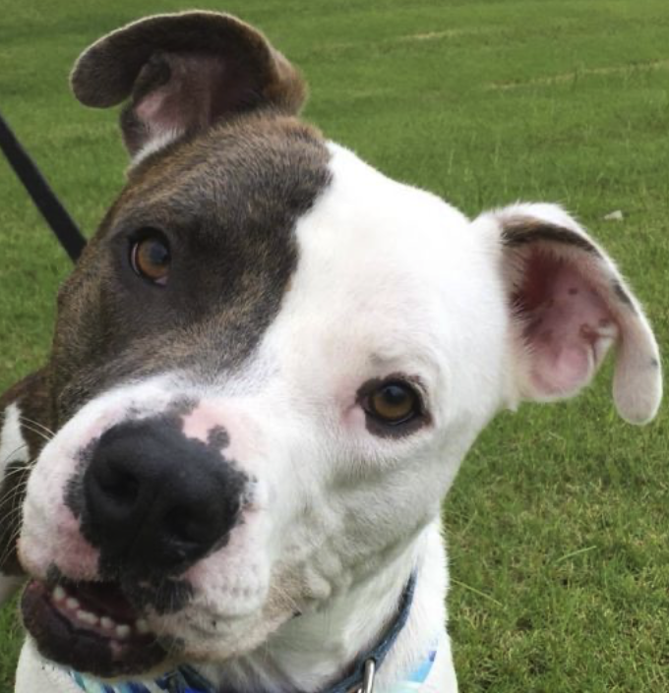
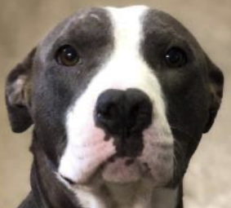
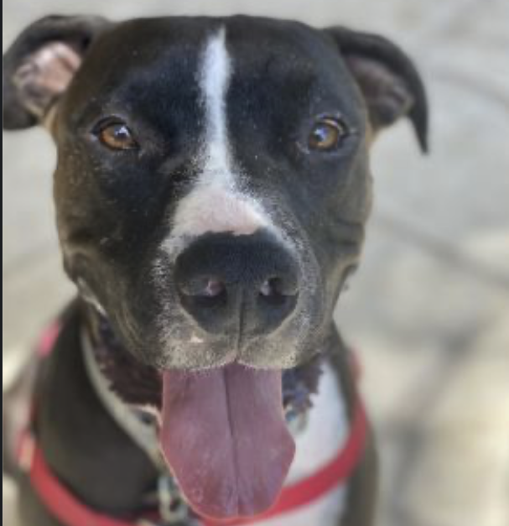
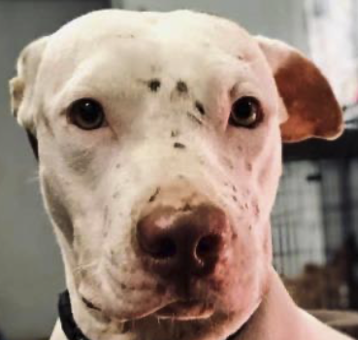
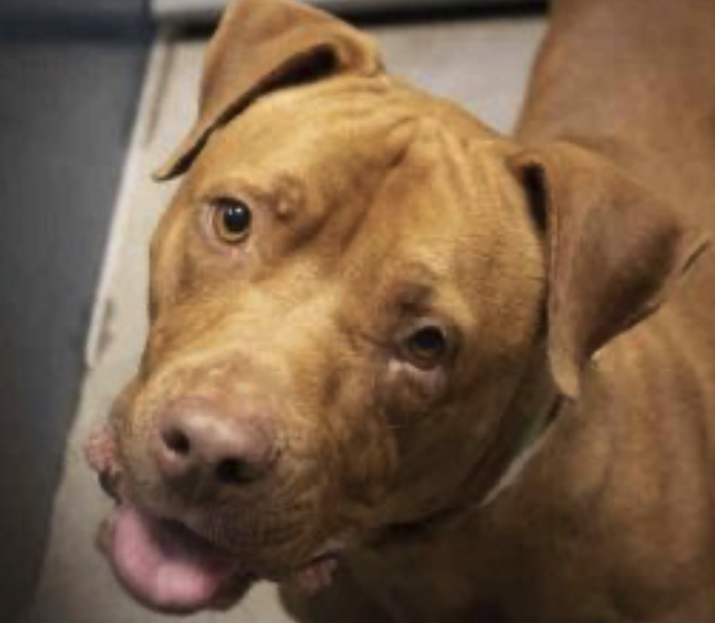
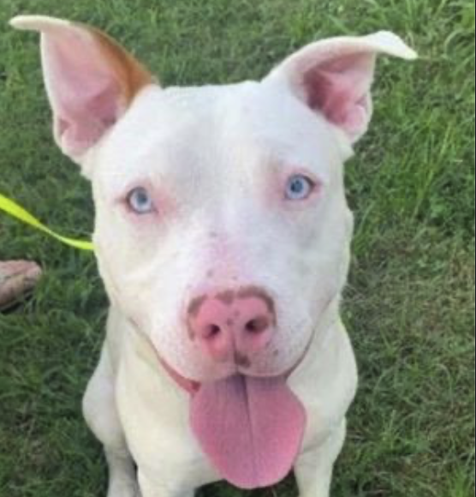
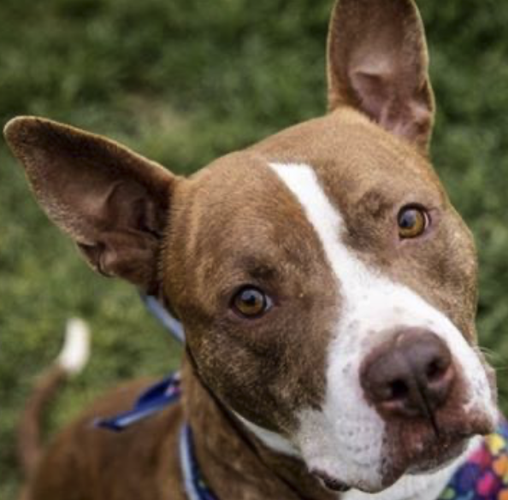
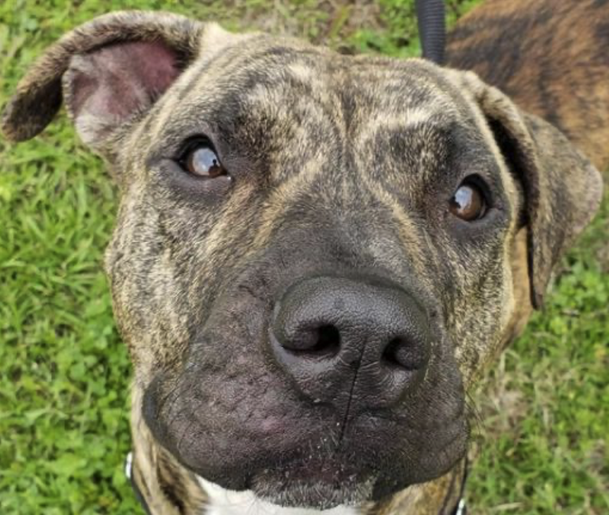
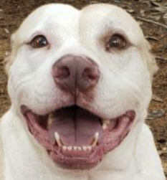
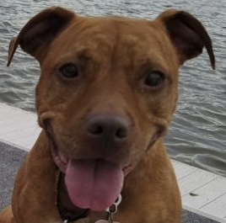
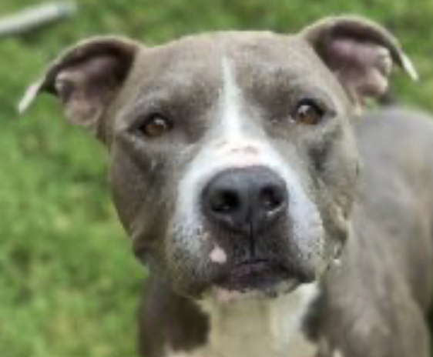
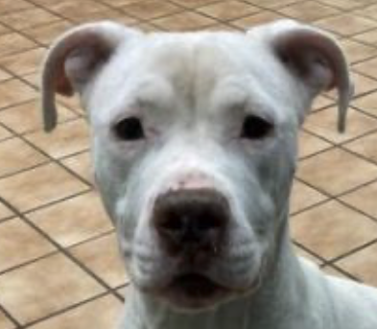
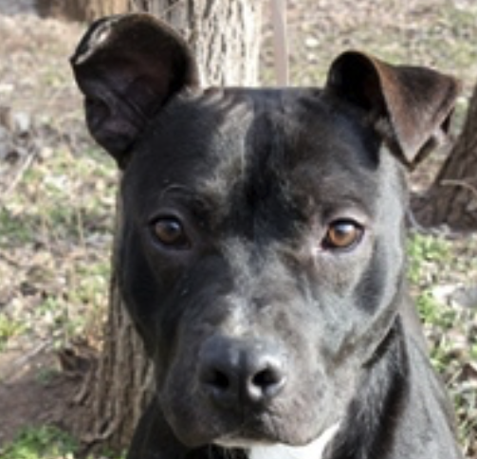
Pit Bulls

Slide 7
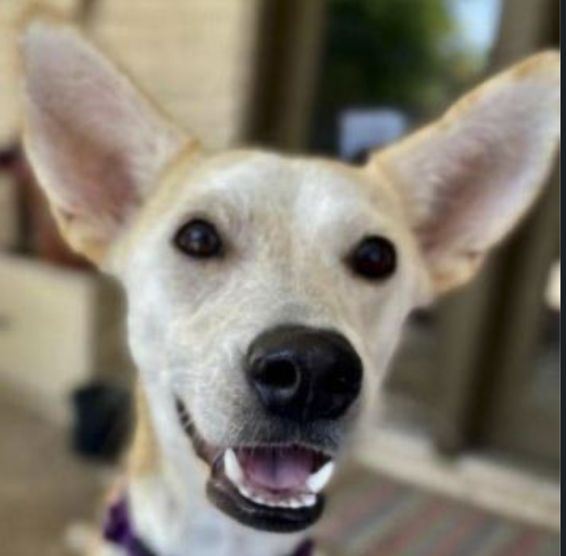
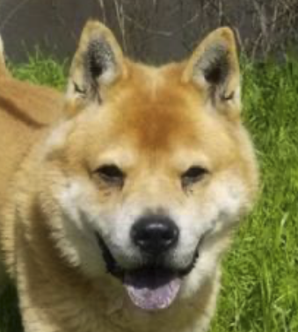
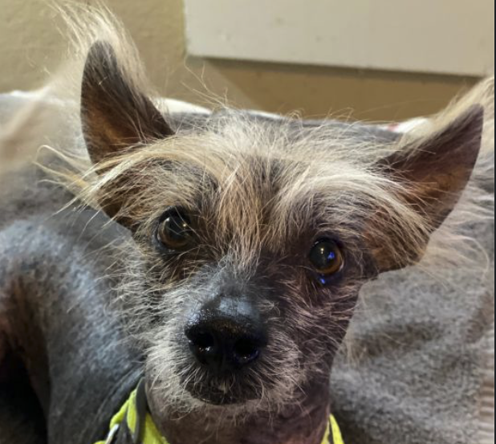
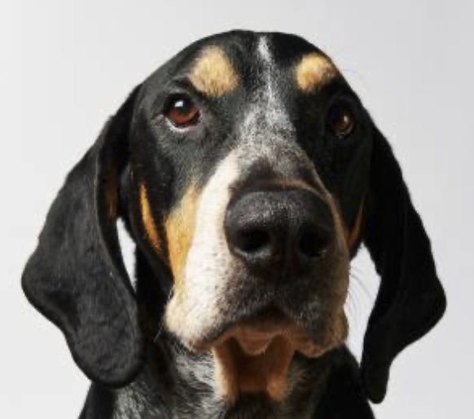
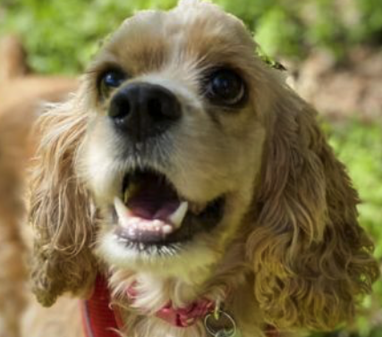
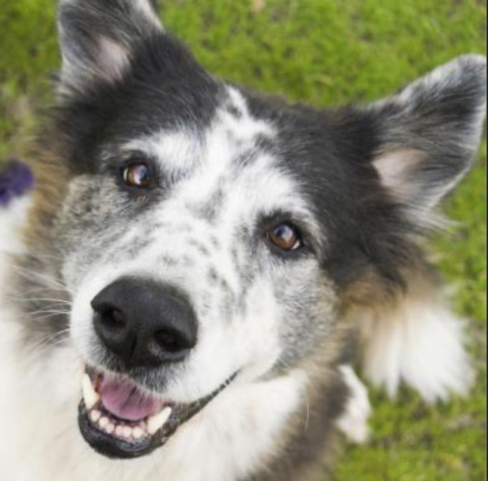
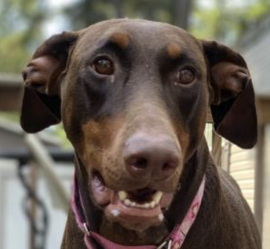
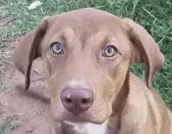
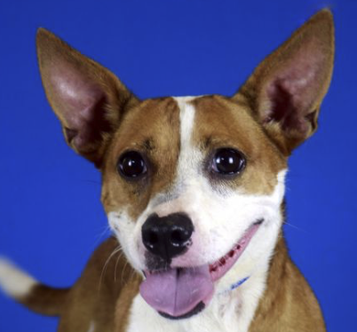
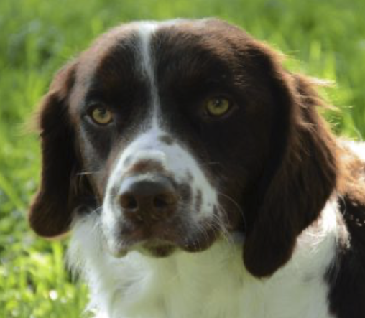
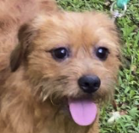
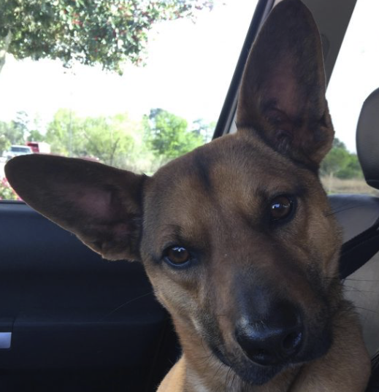
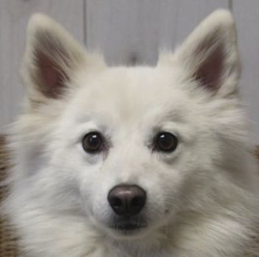
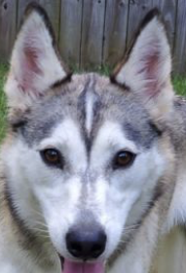
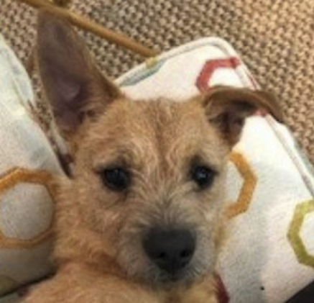
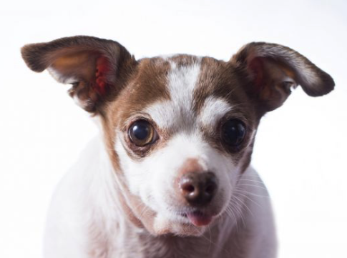
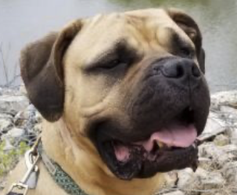
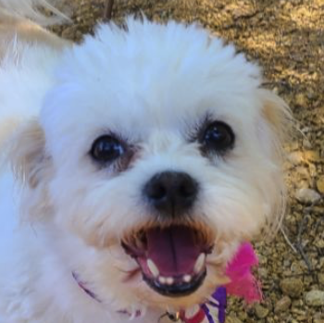
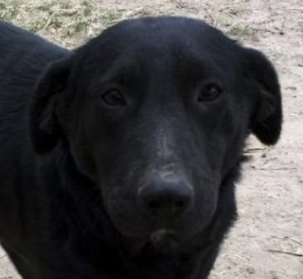










Non-Pit Bull dogs

Slide 8



RoboFlow: Data Augmentation
Grey Scale
25%
Brightness
Flip
Training data: 497 -> 1491 images
Note: Data Augmentation should not be implemented on the testing dataset

Slide 9

Model / Results
4 2D pooling layers
3 dropout layers
Loss function: Binary Crossentropy since there are only two label classes: Pit and Not Pit
Validation data = Test data
Batch size = 16
Testing Accuracy: .651

Slide 10
Conclusions and Future Work
I will keep adding photos to my model.
I would like to expand my project to more breeds.
Image Labeling: Roboflow only offered that feature to the object detection datasets so I would like to figure out another way to use image labeling for my classification problem.
I would like to create an app with flask to upload photos and see results

Slide 11

End
Thank you for your attention

Slide 12

Sources:
Stanford Dogs Dataset: http://vision.stanford.edu/aditya86/ImageNetDogs/
https://github.com/aschleg/petpy/tree/master/notebooks
Graphics
https://www.pinterest.es/pin/634866878691479349/
https://twitter.com/artistonwheels/status/1233066976399855622
https://www.pinterest.com/pin/296182112969223721/
https://www.pinterest.com/pin/781304235331306713/
https://www.pinterest.com/pin/323344448250061364/
https://knowyourmeme.com/memes/people/pitbull

